Slide 1
Mars: Science and Engineering (Week 2)
Howard Seltman
CMU Osher
Fall 2023

Slide 2
Course Outline
Week 1
Astronomy background
Early flights with no or minimal success
Mariner Program
Week 2
1973: Soviet Mars program
1975: US Viking program
1990s: MGS, Pathfinder, Sojourner, Nozomi
Week 3
Early 2000s: Odyssey, Spirit & Opportunity, Mars Express
Late 2000s: Mars Reconnaissance Orbiter, Phoenix lander
Week 4
2010s: Curiosity, MAVEN, Mangalayan, Insight
2020s: Perseverance, Ingenuity, Tianwen, Emirati Hope
Future: EscaPADE, Exo-Mars
Far future: humans on Mars

Slide 4
Pre-Viking Soviet Missions
Mars 4 to Mars 7 were intended for 1973 launch to pre-empt the 1976 US Viking missions, but planetary positioning was poor necessitating smaller payloads in the form of separate orbiter and lander launches
Mars 4 lander could not do course correction to due transistor failure but sent back 12 pictures at 1200 miles
Mars 5 orbiter developed an instrument compartment leak, so it operated in orbit for only 3 weeks and returned about 60 pictures and surface chemical composition data
Mars 6 lander returned data on a near-successful landing but crashed (or lost its radio)
Mars 7 lander failed to enter the Martian atmosphere and remained in heliocentric orbit

Slide 5
Early US Landers
JPL’s Surveyors 1, 3, and 5-7 soft-landed on the moon starting in 1966

Slide 6
The Cancelled “Voyager Mars” Program
“Voyager Mars” was part of the Apollo Applications Program
Planning was in 1966-1968 for 1974 launch with manned missions planned for the 1980s!
Based on Apollo spaceships, but later dismissed based on Mariner data on the Martian atmosphere
First major NASA program cancelled by Congress
Evolved into Viking 1 and 2
(Mariner 11 and 12 were sent to the outer planets and beyond, renamed as Voyager 1 and 2)

Slide 7
Viking Mission Overview
Viking 1 and 2 each comprised an orbiter and a lander to reach Mars in 1976
Cost $1 billion ($5 billion in current value)
Search for life was a major goal
Over 20% of the cost relates to sterilization

Slide 8
Viking Spacecraft

Slide 9
Viking Engineering
5115-pound orbiters, 8 feet in diameter, powered by four 32-foot solar panels (620 watts), similar to the Mariners
Entry, Descent and Landing were the biggest unknowns
Earth landings are based on aerobraking, sub-sonic parachutes, and a water landing (US) or retrorockets (USSR)
Without an atmosphere, moon landings are based on retrorockets (and the lander need not be aerodynamic)
On Mars the atmosphere is thin, but significant
The strategy was aerobraking, hypersonic parachutes, and then retrorockets
1270-pound lander made of aluminum and titanium included RTG power source (60 watts from plutonium-236), twin 18K RAM onboard computers, weather station, seismometer, S-band radio with high and low gain antennas, UHF radio, 2 cameras, surface sampler boom, biology processor, descent engine and propellant tank. Similar to the Surveyors.

Slide 10
Contemporaneous Viking Video
Viking Documentary (12:08) [garbled start, some bad subtitles]

Slide 11
Orbiter Instrumentation
Twin 88-pound television cameras with telescopes and mechanical shutters and 160-megabyte tape recorders
1056 lines by 1182 samples at 7 bits (128 intensity levels)
1 megabyte per picture
Six color filters: blue (0.35 to 0.53 µm), yellow (0.48 - 0.70), violet (0.35 - 0.47), green (0.50 - 0.60), red (0.55 - 0.70), and clear
Each pixel is about 120 feet on a side at 900 miles elevation
Infrared spectrometer for water vapor mapping
Infrared radiometer for thermal mapping

Slide 12
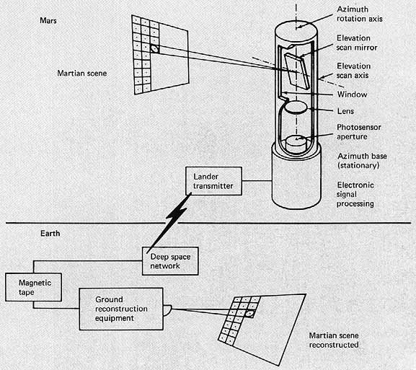
Lander Imager Engineering
Used cutting edge “facsimile” technology that had few moving parts and good balance of reliability and image quality for a reasonable (high) price and weight (16 pounds each)
Image rate is 4.7 lines per second
Could be baked to 110◦ C, and could transmit in real time (no storage) at 16K and 250 bits per second

Slide 13
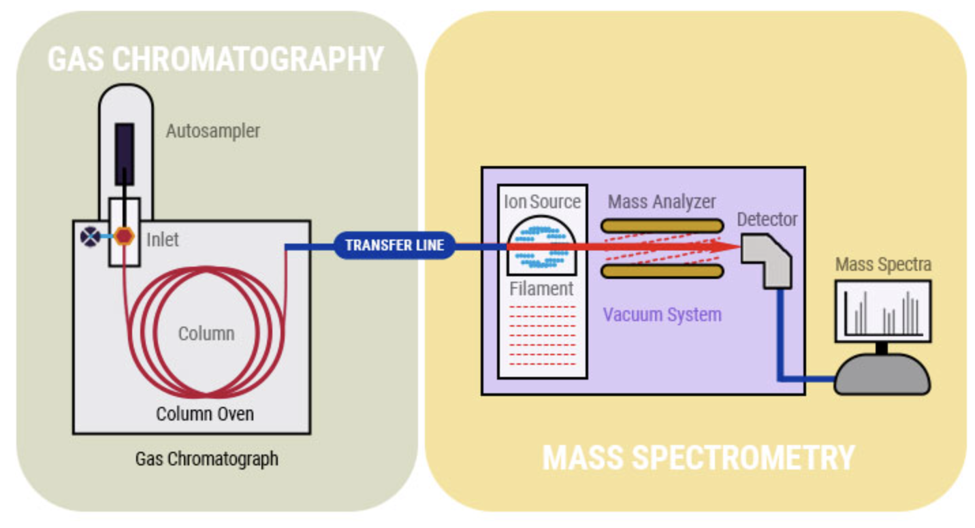
Lander Instrumentation
Gas chromatograph mass spectrometer for organic chemistry analysis of soil
GC separates a mixture of volatile substances based on general chemical and/or physical properties
MS creates ions and fragment ions and measures mass to charge ratio: fingerprints of specific organic chemicals
Needed to get from room-sized to 1 cubic foot
Costs rose from $15 million to $41 million

Slide 14
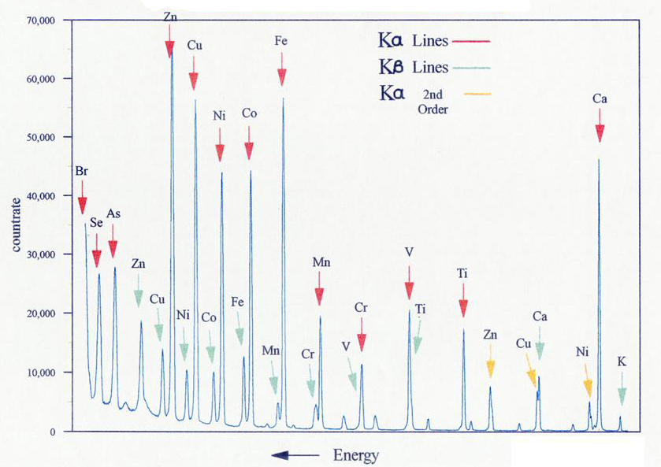
Lander Instrumentation
Seismometer (only detected wind)
X-ray fluorescence spectrometer for composition of heavier elements in rocks and soils
X-rays (from iron-55 and cadmium-109) bombard the soil, then each element produces its own characteristic x-rays, which are counted and recorded
Biological laboratory (3 different instruments)

Slide 15
Biology Experiments in Soil
Contemporaneous Viking Documentary (5:28)

Slide 16
Vikings’ Trip to Mars
Viking 1
Launched August 20, 1975, on Titan / Centaur
Course corrections August 27, 1975, and June 10 & 15, 1976
Entered orbit June 19, 1976 (periapsis 1K mi, apoapsis 20K mi)
Immediately found that the proposed landing site in Chryse Planitia (“Golden Plain”) was rougher than expected, and a new site on its western slope was chosen
Successful landing July 20, 1976 (16 days late). Due to the speed-of-light time delay, touchdown on Earth was recorded 19 minutes after actual touchdown. The first pictures showed nearby rocks large enough to have prevented a safe landing.
Viking 2:
Launched September 2, 1975
Course correction September 19, 1975
Entered orbit August 7, 1976
Re-routed landing in Utopia Planitia
Successful landing September 3, 1976, tilted 8.5◦

Slide 17
Vikings 1 Launch (NY Times, p. 40)

Slide 18
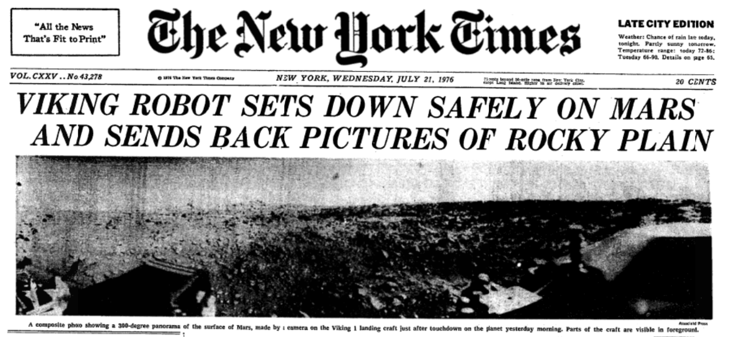
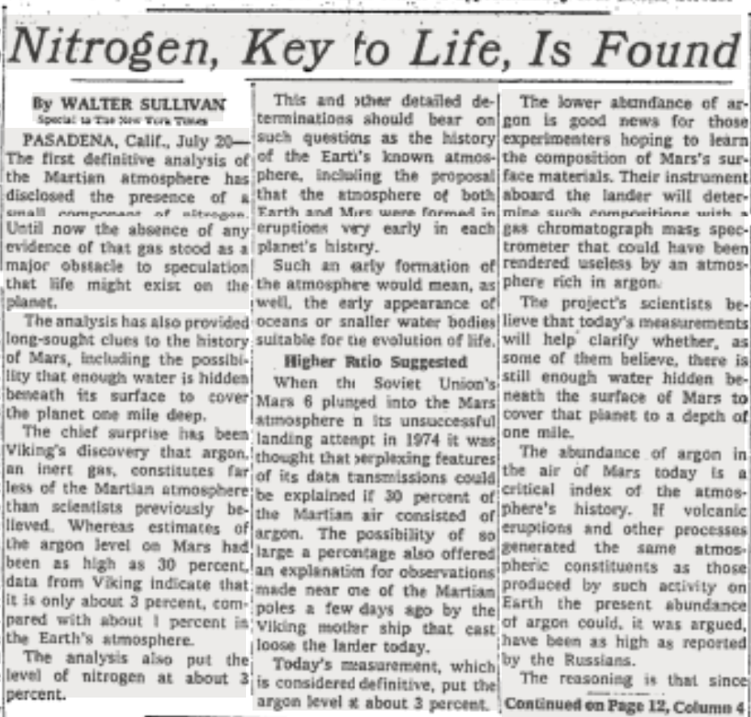
Vikings 1 Landing

Slide 19
First Viking Photographs

Slide 20
Viking Lander Results
Rated for 30 days, Viking 1 lander operated for 6 (Earth) years
Viking 2 lander operated for 3 ½ years
Sky was pinkish rather than blue, due to dust in the air
Winds were measured at 0 to 22 mph, temperatures from -122 to -22 Fahrenheit, pressures from 7 to 8 mbar with a 5% drop as CO₂ froze onto the ice caps
The 6-foot robotic arm scooped up soil and deposited it in the chemistry lab
X-ray fluorescence spectrometry showed primarily silicon and iron, with higher-than-expected sulfur
Biology tests
Results were positive, but generally concluded to be due to chemical oxidants produced by the effect of UV light on the soils
Two original scientists and some recent work dissent
GCMS showed no detectable organic chemicals except chlorinated compounds thought to be cleaning contaminants

Slide 21
Viking Orbiter Results
Orbiters ran out of attitude control gas at 5 and 3 years respectively
North polar ice cap is water ice, not CO₂ (dry ice)
Permafrost (subsurface ice) is prevalent
Moons appear similar in composition to asteroids
Thousands of pictures were taken

Slide 22
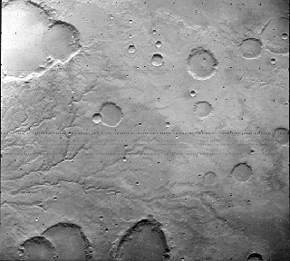
Viking Photo of Drainage

Slide 23
Viking Composite Picture
Valles Marineris

Slide 24
Viking 1 and 2 Summary
Technical wins with first successful EDL and miniaturized GCMS
Clear evidence of past liquid water along with current conditions without liquid water stimulated research in global climate change
Negative biologic results reduced interest in Mars for several years
25th Anniversary (1:42) [original Viking team aged 25 years]

Slide 25
Two Failures: Phobos and Mars Observer
Soviet Phobos 1 and 2 orbiters with landers (1988)
Cooperation of 14 nations including US Deep Space Network
Phobos 1 failed en-route: a single character error in an uploaded program resulted in turning off attitude control, and the batteries ran down
Phobos 2 entered orbit around Mars and took 37 images of Phobos, but failed before the lander could be de-orbited
US Mars Observer (1992)
$813 million orbiter designed to study elemental and mineralogical composition of the surface, gravitational and magnetic fields, temporal and spatial distribution of volatiles and dust, and circulation of the atmosphere
Contact was lost 3 days before planned orbital insertion
Likely cause was fuel and oxidizer leakage through a check valve during cruise resulting in an explosion when the engine was restarted for course correction

Slide 26
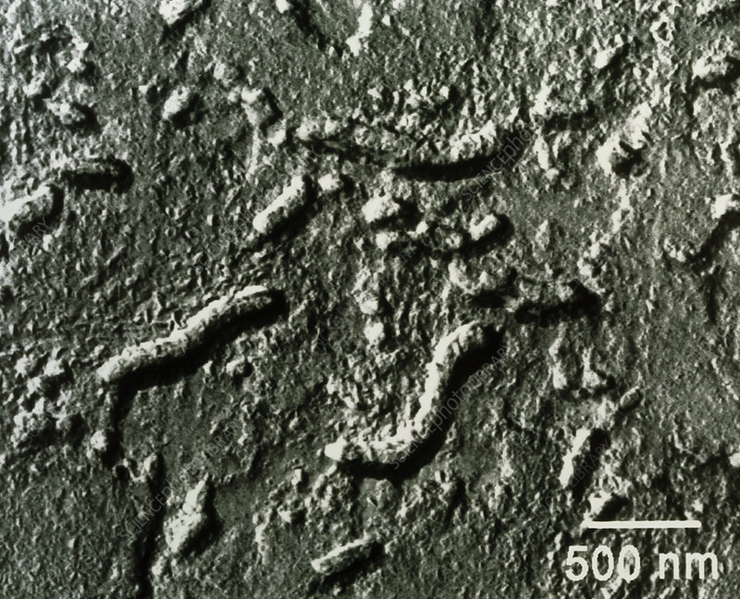
Digression: Allan Hills 84001
Meteorite fragment found in Allan Hills Antarctica in 1984
Consensus Scientific Results
Crystalized 4 billion years ago on Mars
Blasted off Mars by a meteorite 17 million years ago
Landed on Earth 13,000 years ago
Claims from McKay, et al. in Science, August 1996
Bacteria-like structures found by scanning EM
20-100 nm in diameter (smallest Earth bacteria are 200-300 nm)
Used to bolster interest in detecting life on Mars
Current consensus is that these may be abiotic, and that morphology alone is too subjective to be used to declare life

Slide 27
Three Mars missions launched in late 1996
Russia’s Mars 96
Orbiter with 26 instruments built by multiple countries
Two penetrators with 9 instruments each to measure ~15 feet into the surface
Two landers with 8 instruments each
Successfully placed in Earth parking orbit
Failed ignition of rocket to leave Earth orbit
Probably fell over Chile with 200 gm of plutonium-238, never recovered
US Mars Global Surveyor
Launch November 1996
Entered Mars orbit September 12, 1997
Long orbital adjustment period via aerobraking
Mapping began March 1999
Operated until November 2006
US Pathfinder lander with Sojourner rover
Launch December 1996
Landing July 4, 1997
Operated until September 27, 1997

Slide 28
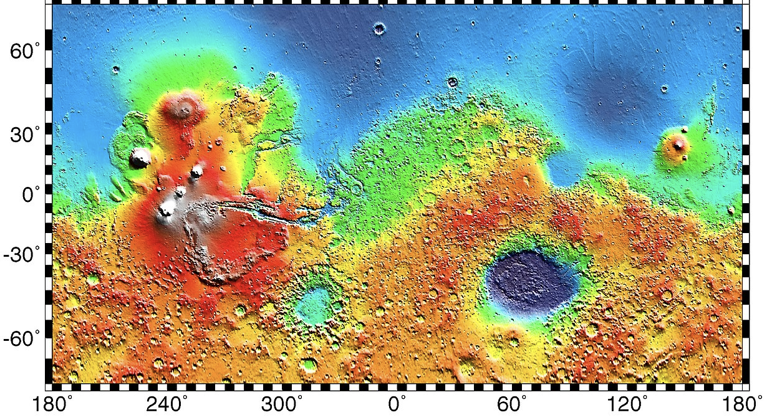
Mars Global Surveyor
Mapping mission designed to scout out landing sites
240,000 pictures at about ¼ mile resolution
First use of laser altimeter in space
Also measured temperature and magnetic fields
Polar orbit allowed essentially 100% coverage of the surface
Blue = low
Red and
Grey = high

Slide 29
Pathfinder and Sojourner (Truth)
Follow-up to 1975-1976 Viking landers
Part of the post-Cold-War “cheaper, faster, better” Discovery Program of NASA administrator Dan Goldin
Project manager: Tony Spear
20th Anniversary: Initial idea (1:56) [Charles Elachi of JPL]
$150 million lander and $25 million rover
20th Anniversary: Development overview (6:31) [Brian Muirhead of JPL]
Landed July 4, 1996, on a plain 2.4 km below the average planetary surface altitude called Chryse Planitia in the north equatorial region
20th Anniversary: Control Room with artist renderings of the landing (5:35)

Slide 30
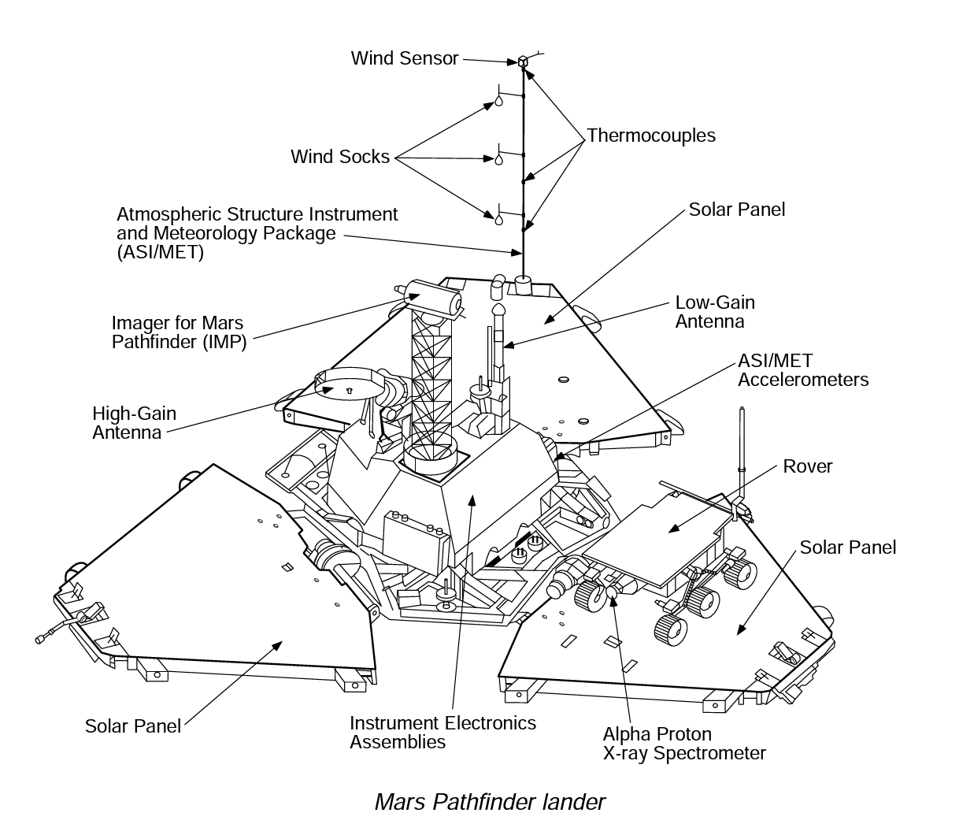
Pathfinder Lander
3 feet tall, 1973 pounds at launch, 793 pounds at landing
IBM computer at 20 megaflops with 128 megabytes RAM
Stereo CCD cameras
with 12 color filters,
256x256 pixels
Weather station
Radios

Slide 31
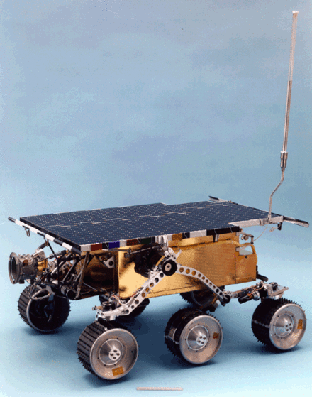
Sojourner (Truth) Rover
Named by the 12-year-old winner of a student competition to submit an essay about the historical accomplishments of a heroine
25 pounds, solar panels and a non-rechargeable battery, front and back cameras, radio, alpha proton x-ray spectrometer
Warm electronics box, rocker bogie with 6 independently actuated wheels, front and rear steering, obstacle avoidance, 1.5 ft/sec

Slide 32
Sojourner (Truth) Rover: Instrumentation
APXS: Curium 244 (half life 18 years) emits alpha particles and measures alpha particles, protons, and x-rays scattered or emitted to determine elemental composition in the first few tens of µm of soil
Mounted on an actuator with contact sensors
Each measurement takes tens of hours

Slide 33
Rover and Donna Shirley
Donna Shirley was a pilot and an aerospace engineer who worked at JPL on heat shields, rovers and robotics
Shirley was manager of the Mars Exploration Program at JPL, a key advocate of the rover, and the first woman Program Manager at NASA
NBC News (4:00) [A few garbled seconds]
Donna Shirley Hall of Fame: Sojourner (4:01)

Slide 34
Pathfinder and Sojourner Science Results
Proved the workability of airbags for EDL
Lander returned 16,500 images
Pioneered Mars rover technology: 550 pictures, 40 feet from the lander, 330 feet total, collected APXS data at 16 locations
Lander provided extensive weather data including evidence of frequent dust devils and early morning water ice clouds
Found rounded rocks thought to be evidence of a time of flowing water
Found high silica content in rocks, different from the few Martian meteorites found on Earth
Soil chemistry was similar to Viking 1 and Viking 2, suggested planet wide circulation of soil and dust
Radio tracking of Pathfinder and its rotation was used to determine that the planetary core is 800 to 1250 miles in radius
Airborne dust was found to contain a magnetic form of iron oxide about 3 µm in diameter

Slide 35
Winter 1998/1999 Launches
US Mars Climate Orbiter ($327 million)
Designed to study atmosphere, climate and surface and do radio relay
Failed at Mars orbit insertion due to Lockheed Martin’s failure to convert English to metric units
US Mars Polar Lander ($165 million)
Designed to study soil and climate at the south pole
“The Failure Review Board concluded that the most likely cause of the mishap was a software error that incorrectly identified vibrations, caused by the deployment of the stowed legs, as surface touchdown. The resulting action by the spacecraft was the shutdown of the descent engines, while still likely 40 meters above the surface.”
Japanese Nozomi (“Hope”)
Designed to study Mars’ atmosphere and its interaction with the solar wind
Designed to use moon and Earth swingbys to reduce fuel expenditure
Valve failure during the Earth swingby left insufficient fuel
Mission changed to heliocentric orbit with Mars flyby in December 2003
Did provide data about deep space

Slide 36
Summary of Week 2
Russia continues to fail in the 1990s, joined by Japan
US has a mix of successes and dramatic failures under NASA administrator Dan Goldin’s “faster, better, cheaper” approach

Slide 37
What’s next
Early 2000s: Odyssey, Spirit & Opportunity, Mars Express
Late 2000s: Mars Reconnaissance Orbiter, Phoenix lander

Slide 38
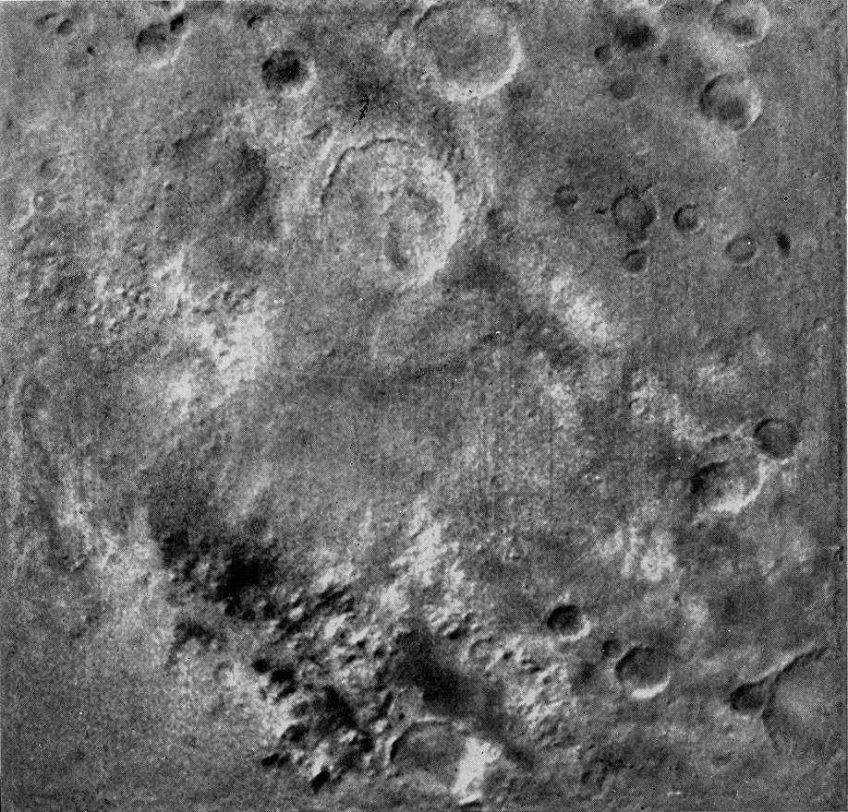
Pre-Viking Soviet Missions
Mars 4 to Mars 7 were intended for 1973 launch to pre-empt the 1976 US Viking mission, but planetary positioning was poor necessitating smaller payloads in the form of separate orbiter and lander launches.
A high failure rate of transistors made with aluminum rather than gold contacts predicted a 50% failure rate, but the missions were continued
Mars 4 lander could not do course correction to due transistor failure but sent back 12 pictures at 1200 miles.

Slide 39
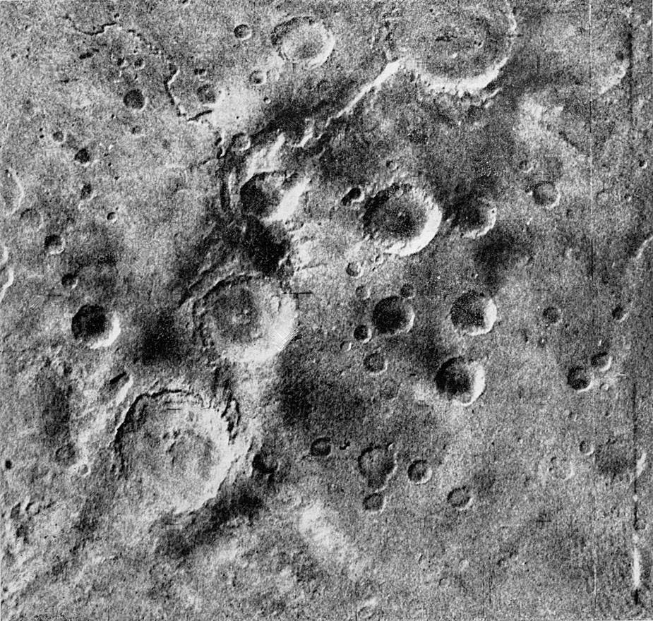
Pre-Viking Soviet Missions
Mars 5 orbiter successfully performed course corrections and entered Martian orbit February 2, 1974
A leak of the pressurized instrument compartment was detected, probably due to a micrometeroid, and only three weeks of operation was predicted. This meant the landers would have no orbiting relays.
An accelerated program of photography and scientific instrument observation was devised
Chemical composition of rocks was measured for the first time

Slide 40
Pre-Viking Soviet Missions
Mars 6 was a lander with a flyby component
Multiple problems developed, one by one, with partial recovery by backup systems
Lander data rates were greatly reduced due the need for direct communication with Earth
The lander detached and decelerated, and the parachutes deployed but with evidence of instability
The first direct measurements of the Martian atmosphere were made: temperature and pressure and about 1/3 argon as measured by mass spectrometry (real value 1.6%)
Landing engines ignited, but no further data was received
Possible explanations include failure of the radio system or landing on large rocks
The Mars 7 lander failed to fire retro rockets and did not enter the Martian atmosphere

Slide 41
Viking Rockets and Guidance
Titan III-Centaur
Solid booster rockets (polybutadiene acrylonitrile) assist main hydrazine/dinitrogen tetroxide engines
Hydrazine/dinitrogen-tetroxide second stage
Liquid hydrogen / liquid oxygen third launch stage
Hydrazine/dinitrogen-tetroxide engine on the spacecraft, plus compressed nitrogen attitude control jets
Course corrections based on Deep Space Network observations on Earth

Slide 42
Entry, Descent and Landing
Biggest unknown: atmosphere too thin for Earth-like landing and too thick for Moon-like landing
Deorbit burn
Enters the atmosphere of Mars about 100 miles above the surface, traveling at about 18,000 miles per hour
Seven minutes later, it has to be traveling at one or two miles an hour to make a soft landing
Aeroshell braking until 3.7 miles and 600 mph
Supersonic parachute until about 5000 feet (by radar) when backshell separation occurs
Throttleable rockets slow to 1.5 mph
Shock absorbing legs
All with no Earth intervention (40-minute round trip communication delay)

Slide 43
Biology Experiments in Soil
Gas Exchange
Looked for a change in oxygen, CO2, nitrogen, hydrogen, or methane after adding nutrients or nutrients plus water
Labeled Release
Added radioactive ¹⁴C labeled nutrients, then looked for ¹⁴C labeled gasses in the air above the soil
Subsequently the samples were heated to 160 ℃ and retested as a control
Pyrolytic release
Looking for carbon fixation through photosynthesis, ¹⁴C carbon dioxide and carbon monoxide were incubated with the soil for several days, then release of radioactivity from the soil was observed as it was heated

Slide 44
Engineering Management
from Thomas A. Mutch and Kenneth L. Jones in “The Martian Landscape” (https://history.nasa.gov/SP-425/contents.htm)
Described about 400 meetings over 8 years in four locations:
“Useful exchanges of information prevented isolated journeys up blind alleys. When no obvious solution to a problem was apparent, we proceeded by vote. The majority opinion dictated the next step. In one sense, that appears absurd. Certain things are matters of fact. To what useful end can one vote on the proposition that a camera should cost no more than X dollars, whereas a biology instrument should cost Y dollars? Or that the average Martian atmospheric pressure is 1 percent of the Earth's atmosphere as opposed to 0.5 percent? Viewed in another context, an open meeting in which all participants have equal vote has served Americans well in many previous situations. Perhaps more than we realize, it is a method of pooling information with which we have grown up. I like to think that the ultimate success of Viking can be traced back to those countless meetings at which we chewed on one problem after another- hours of thoughtful criticism and, sometimes, clamorous sharp-edged debate.”

